Slide 1




Hoax Detector
Aravindhan G
Pirthvi Hasan G

Slide 2
What Is Fake News ?
Fake News Stories usually spread through social media sites like Facebook, Twitter and Reddit.
Fake News is designed to deliberately spread hoaxes, propaganda and disinformation.
Often Fake News will mimic real headlines and twist the story.

Slide 3
OBJECTIVE
The Idea is to classify the News into Real/Fake using Features from the Text Content of the article.
Title and Text of the article are taken as input and to perform Feature Engineering using Regular Expression & Analyse to predict the outcome.

Slide 4

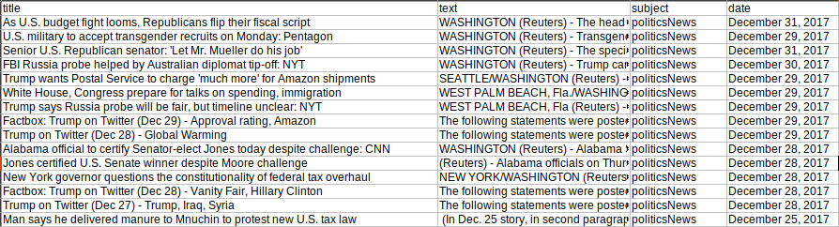
DATASET (Source)
Data is divided into two categories :-
True news &
Fake news.

Slide 5
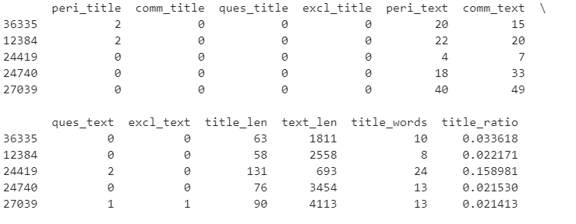
DATASET
Both Datasets are combined into a single Data.
New Features are extracted from data & further analysis are made.

Slide 6
FUNCTIONS USED
Lexical Diversity :-
To find unique vocabs used in Fake News articles.
( Lexical diversity = No. of unique words in target (Fake) category / No. of words in both(True, Fake) categories ).
Common Words :-
To find the common words used in both real news and fake news.
Punctuation Count :-
To count the number of occurrences of various punctuations in the Titles and the Text of both categories.

Slide 7
FUNCTIONS USED
RandomForestClassifier :-
Machine Learning model in sklearn library to perform Ensemble method classification.
Train Test Split :–
Inbuilt Function in sklearn library to split the dataset into training and testing components.

Slide 8
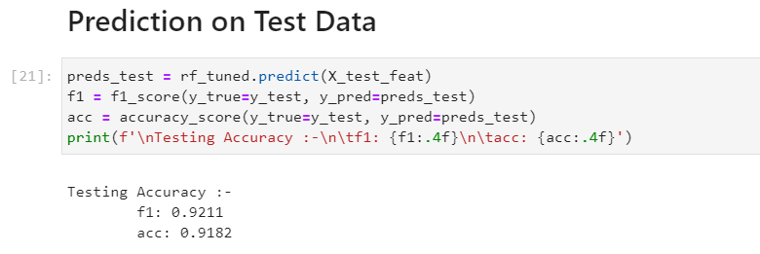
RESULTS
The Random Classifier model is build with the accuracy of 91.82 %.

Slide 9
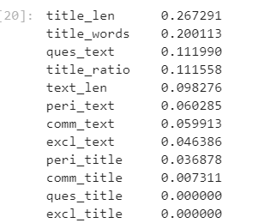
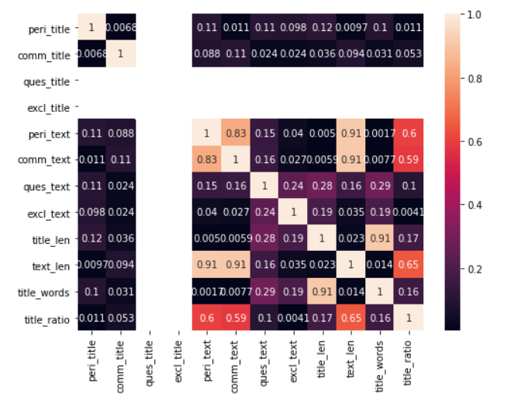
RESULTS
Important features to build model
Heatmap of Features

Slide 10

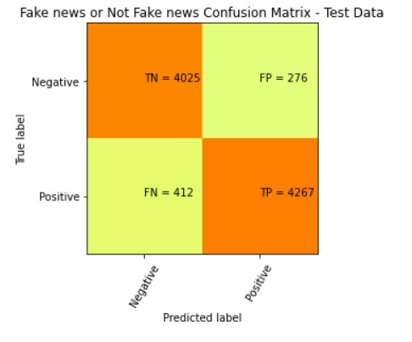
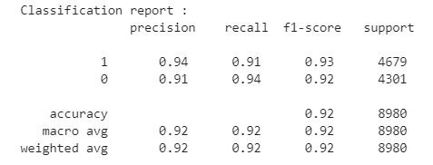
RESULTS
Confusion Matrix of ML Model.
Classification Report

Slide 11
INTERPRETATION
Most common words used in Real news are Trump, US, White House, Senate,etc.
Most common words used in Fake news are Video, Trump, Watch, Obama, Hillary, etc.
Average punctuations used in Titles in both fake and real news is 0.15
Average punctuations used in Text in both fake and real news is 10.5.

Slide 12
INTERPRETATION
Average number of words in fake news is 18
Average length of fake news is :-
Text : 2470 characters,
Title : 80 characters.
Fake news Title contain Five times less dots(.), Ten times more question marks(?), exclamation mark (!) than real news.
Titles of Fake News are 50% longer. The number of words seems to reflect that fact as well.

